Slide 1
Report
for Aug 2020 MP
BFX - AT100
Date : 03 Sep 2020
Prepared by: Heng Ruan

Slide 2
Issue Description
5 June 2020, ALT customer complain [BFX-AT100] May 2020 Mass production issue.
Defect Total:
1. HDMI output noise (Critical ) : 2/500pcs (0.4%)
2. Can not google login with RCU (Critical) 1/500pcs (0.2%)
3. SET label print is not completely (Major) : 1/500pcs (0.2%)
4. Ethernet cable packing NG (Major) : Not counted (20%)

Slide 3

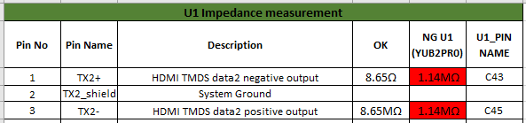




1. No HDMI output
Issue Description | Root Cause | Actions | Owner | Due Date | Status
Phenomenon: No HDMI output. Type: Critical Q’ty : 2/500pcs DR: 0.4% SN:2149688001202005107167 | 1. Checked history: This unit was passed all stations smoothly. 2. Re-Check at factory: Failed Function. - Retest FT station: Result FAIL (HDMVID:HDMI Video 4K60Hz test fail). - Retest FT1 station: Result FAIL (AU4K05: HDMI AUDIO 4K Value is High). 3. Visual inspection: did not find out abnormal. 4. X-ray: U1 - Did not find out abnormal. 5. Use multi-meter to check power P5V, P1V2, P2V5,P3V3, P1V8_eMMC P2V5,VDDCPU and VDDEE no issue found. 6. Check power when HDMI cable connect U1_J41( HDMI_TX0+), U1_J43( HDMI_TX0-) had abnormal. 7. Measuring impedance pin 1, pin 3 of J1401 find out U1_C43( HDMI_TX2+), U1_C45( HDMI_TX2-) had abnormal. 8. Check console information did not see abnormal. Please see attached file for detail measurement: Suspect U1(BGA) component issue. | Measuring impedance pin 1, pin 3 of J1401 find out U1_C43( HDMI_TX2+), U1_C45( HDMI_TX2-) had abnormal. 2. Change new U1 (BGA) then pass. U1(BGA) component issue. 3. FXN SQE was responsible to inform for vendor this issue.( SQE send NG material to Vendor for future analysis 07-Dec-2020 ) 4. Waiting vendor analysis and give out action. | PE-Loc TE-Allan SQE-Khoa | 25-Dec

Slide 4
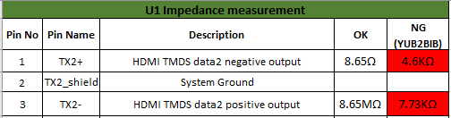
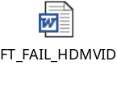
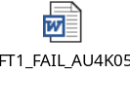
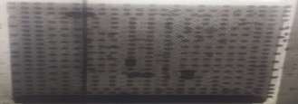
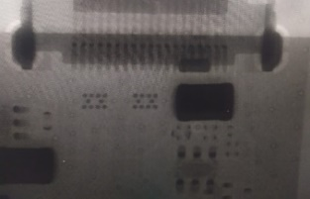

1. No HDMI output
Issue Description | Root Cause | Actions | Owner | Due Date | Status
Phenomenon: No HDMI output. Type: Critical Q’ty : 2/500pcs DR: 0.4% SN:2149688001202005131536 | 1. Checked history: This unit was passed all stations smoothly. 2. Re-Check at factory: Failed Function. - Retest FT station: Result FAIL (HDMVID:HDMI Video 4K60Hz test fail). - Retest FT1 station: Result FAIL (AU4K05: HDMI AUDIO 4K Value is High). 3. Visual inspection: did not find out abnormal. 4. X-ray: U1- Did not find out abnormal. 5. Use multi-meter to check power P5V, P1V2, P2V5,P3V3, P1V8_eMMC P2V5,VDDCPU and VDDEE no issue found. 6. Check power HDMI cable connect did not find out abnormal. 7. Measuring impedance pin 1, pin 3 of J1401 find out U1_C43( HDMI_TX2+), U1_C45( HDMI_TX2-) had abnormal. 8. Check console information did not see abnormal. Please see attached file for detail measurement: Suspect U1(BGA) component issue. | Measuring impedance pin 1, pin 3 of J1401 find out U1_C43( HDMI_TX2+), U1_C45( HDMI_TX2-) had abnormal. 2. Change new U1 (BGA) then pass. U1(BGA) component issue. 3. FXN SQE was responsible to inform for vendor this issue.( SQE send NG material to Vendor for future analysis 07-Dec-2020 ) 4. Waiting vendor analysis and give out action. | PE-Loc TE-Allan SQE-Khoa | 25-Dec

Slide 5

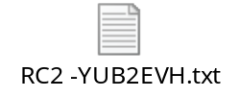
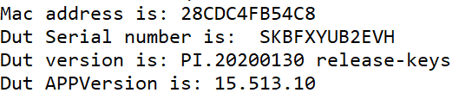
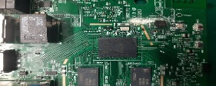


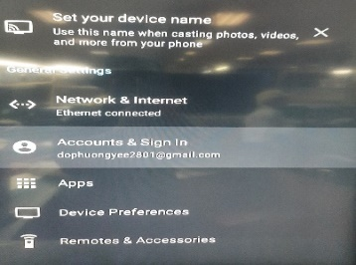
2. Can not google login with RCU
Issue Description | Root Cause | Actions | Owner | Due Date | Status
Can not google login with RCU Type: Critical Q’ty : 1/500pcs DR: 0.2% SN:2149688001202005119978 | 1. Check production data no found abnormal issue. 2. Check log test history data of device. - RC1 & RC2 test station log (Date: 28/7/2020): Check App version: 15.513.10; Check DUT version: 20200130. 4. Visual inspection & X-ray U1 did not find out abnormal 5. Check the power: P5V, P3V3, P1V8, P1V8_EMMC, P1V2, P2V5,VDDCPU and VDDEE did not found abnormal. Suspect Flash (U602), U1 (BGA) components issue. | 1. Write MAC by hand and update correctly FW: 15.513.10 for this device. 2. Re-checked at OBA test station: FAIL Found out can not login Google Issue . 3. Suspect Flash(U602) component issue, replace new eMMC (U602), write Mac by hand and update FW 15.513.10 FAIL: device still can not login google. - Suspect U1(BGA) component issue, replace new U1, write Mac by hand and update FW 15.513.10. PASS: Device logins google nomarlly. U1(BGA) component issue. Waiting PE engineer swap U1(BGA) and Flash(602) to and another device. | PQE-Hang PE: Loc | 15-Dec

Slide 6
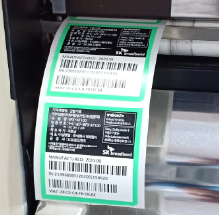
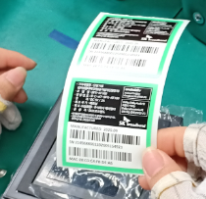
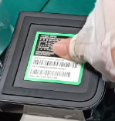



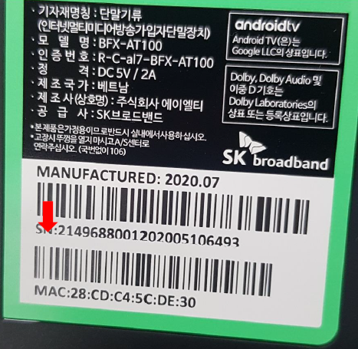
3. SET label print is not completely
Issue Description | Root Cause | Actions | Owner | Due Date | Status
Phenomenon: SET label print is not completely Type: Major Q’ty : 1/500pcs DR: 0.2% | Root cause: - This is maybe the technical errors. Make print out content text not full, as customer info. Escaped cause : - OP printer label and Op visual inspection don’t careful check print content. | 1. Add NG picture to SOP printer label and visual inspection station. 2. Training OP online by quality Alert issue. 3. Line leader often check and monitor all operators at all stations to make sure their operating comply with SOP. | IE: Huyen PD: Dung IT:Phuc | done
Print label
Check after print
Paste label on housing

Slide 7
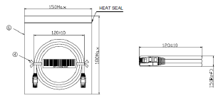
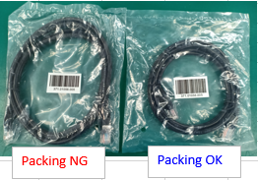

4. Ethernet cable packing NG
Issue Description | Root Cause | Actions | Owner | Due Date | Status
Phenomenon: Ethernet cable packing NG Type: Major Q’ty : 1/500pcs DR: 0.2% | Vendor root cause: The Ethernet have 2 kind packing method, Normal the cable have to tie maximum is 120 (+-10 ) mm, but the NG Ethernet cable is 150mm. This is cause incoming material have 2 kind mix together in carton box. Escaped cause (at FXN): IQC inspection incoming material follow AQL 0.4 , So no defect this issue. All accessory no test function online, just test OBA follow AQL 0.65. - Online production this is accessory material , packing inside PE bag, no any notice from QA, no reject this issue. | FXN SQE was responsible for inform to vendor this issue, remark this issue on vendor side, Waiting sorting result from vendor. FXN action: - Remark from IQC new coming material inspection this issue, - Showed NG sample and re-trained operator at put accessory station for checking requirement. - Line leader often check and monitor all operators at all stations to make sure their operating comply with SOP. | SQE-Khoa IQC: Long PD:Dung | done

